Slide 1
IDS Final Project Report Proposal
By Eddie, Ben, Sarah and Callum

Slide 2
Dataset Introduction
The dataset we will be using for the project will be the World Happiness Report.
The dataset was found on the website Kaggle (https://www.kaggle.com/datasets/unsdsn/world-happiness)
The dataset uses the variables of
Country, Region, Happiness rank, Happiness score, Standard error, Economy(GDP), Family, Health (Life Expectancy), Freedom, Trust (Government Corruption), Generosity and Dystopia Residual
The dataset we are using was collected in 2015.

Slide 3
Dataset Introduction Continued
The dataset is used to help governments, organizations and civil society to inform their policy-making decisions.
The happiness rank and score data was collected by the Gallup World Poll.
The Gallup World Poll is said to be “the most comprehensive and farthest-reaching survey of the world”.
On the Gallop website it is stated that the survey connects with more than 99% of the world's adult population through annual, nationally representative surveys with comparable metrics across countries.

Slide 4
General Research Question
The General Research Question we will be analysing is
How do a Range of factors affect worldwide happiness?
We selected this question as mental health is a prominent issue in society and analysis of the data in this way could give some indicators of ways to improve the overall happiness of a country.

Slide 5
General Research Question Variables
The variables we think will best suit our question and hypotheses are, government trust, how the country is doing in terms of GDP and economy, the countries citizen freedom rating and the projected life expectancy of its citizens.
And how these factors can vary independently and jointly with the countries happiness rating.
If factors are proportional or inverse with each other.

Slide 6
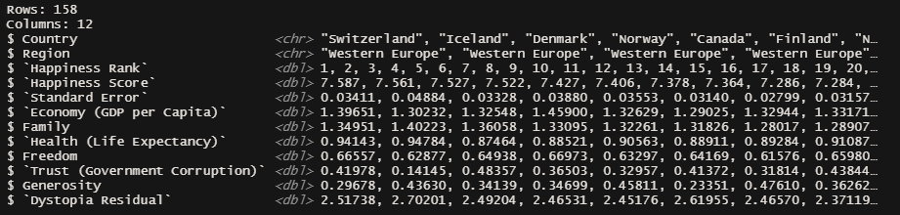
Glimpse(
This Glimpse shows our chosen dataset in Rstudio. It shows all the variables and some of the rows

Slide 7
Hypothesis
We hypothesise that in countries with higher GDP and freedom rating , the happiness score will be higher than countries with a lower GDP and freedom rating. Therefore the GDP and Freedom Rating are proportional to the happiness score.
And
We hypothesise that in countries where Government Corruption is higher, the happiness score will be lower than in countries with less government corruption. Therefore government corruption and happiness score will vary inversely with each other.

Slide 8
Statistics supporting Hypothesis

Slide 9
Summary Stats
 | Happiness Score | Economy (GDP) | Trust (Government Corruption) | Health (Life expectancy) | Freedom
Mean | 5.38 | 0.846 | 0.143 | 0.630 | 0.429
Max | 7.59 | 1.69 | 0.552 | 1.03 | 0.668
Min | 2.84 | 0 | 0 | 0 | 0
Happiness Score: asks respondents to rank there life from 0-10 compared to the perfect life.
Economy: The extent to which GDP contributes to the calculation of the Happiness Score.
Health: The extent to which Life expectancy contributed to the calculation of the Happiness Score
Freedom: The extent to which Freedom contributed to the calculation of the Happiness Score
Trust: The extent to which Perception of Corruption contributes to Happiness Score.

Slide 10
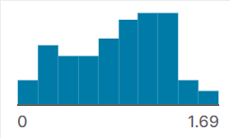
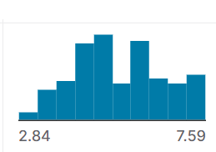
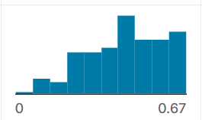
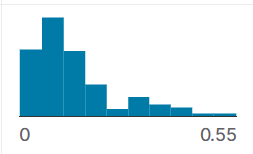
Data Visualisation of each variable
Economy (GDP)
Happiness Score
Freedom
Trust (Government Corruption)

